Slide 1
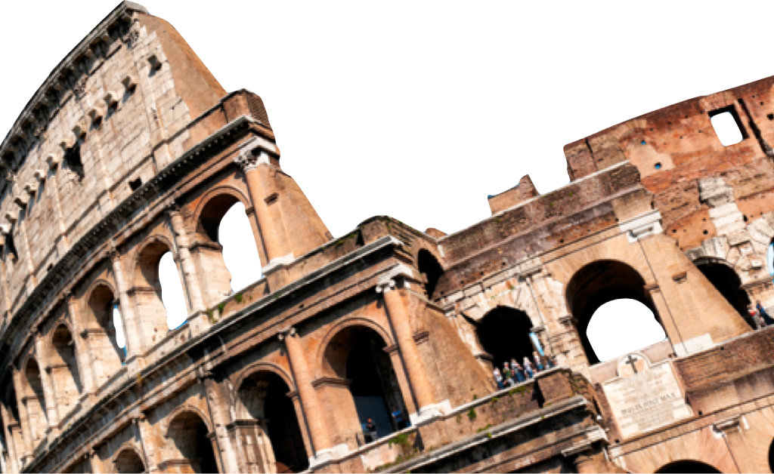
ROMANS
Christian Assurance &
Sanctification
Romans 8:12-25
Laying a solid foundation
Jesse McLaughlin

Slide 2
Assurance of Adoption
Romans 8:12-17
¹² So then, brethren, we are under obligation, not to the flesh, to live according to the flesh— ¹³for if you are living according to the flesh, you must die; but if by the Spirit you are putting to death the deeds of the body, you will live. ¹⁴ For all who are being led by the Spirit of God, these are sons of God. ¹⁵ For you have not received a spirit of slavery leading to fear again, but you have received a spirit of adoption as sons by which we cry out, “Abba! Father!” ¹⁶ The Spirit Himself testifies with our spirit that we are children of God, ¹⁷ and if children, heirs also, heirs of God and fellow heirs with Christ, if indeed we suffer with Him so that we may also be glorified with Him. ^{(NASB)}

Slide 3
Led by the Spirit
The Christian is “under obligation” or as the ESV states “we are debtors”. The obligation is to live according to the Spirit.
“Man’s chief end is to glorify God, and to enjoy him forever.” -Westminster Shorter Catechism
This “putting to death” (v. 13) is known as _____________.
The life of the Spirit is not just enjoyed in the future instead it is a way of life hear and experienced as we learn to carry ourselves as the “sons of God” (v. 14).
Mortification

Slide 4
Spirit of Adoption
The slave to sin must always live in fear of God’s wrath on the Day of Judgment but the adopted son is freed from the fear of judgment.
The ability to call almighty God Abba (Aramaic) & Father (Greek) was modeled by Jesus in Mark 14:36 and demonstrates the change in position that our adoption has accomplished.
The fact that the Spirit dwells within us give us assurance that we are indeed God’s child.
We have the privilege of entering the sufferings of Christ: rejection and injustice from the world and physical death. Yet as “heirs with Christ” we also look forward to the coming glory!

Slide 5
“Each verse gives us an example of the Holy Spirit’s ministry of inward assurance, as he convinces us of the reality of God’s love on the one hand and of God’s fatherhood on the other.”
– John Stott

Slide 6
Assurance of Future Glory
Romans 8:18-25 (NASB)
¹⁸ For I consider that the sufferings of this present time are not worthy to be compared with the glory that is to be revealed to us. ¹⁹ For the anxious longing of the creation waits eagerly for the revealing of the sons of God.²⁰ For the creation was subjected to futility, not willingly, but because of Him who subjected it, in hope ²¹ that the creation itself also will be set free from its slavery to corruption into the freedom of the glory of the children of God. ²² For we know that the whole creation groans and suffers the pains of childbirth together until now.

Slide 7
Assurance of Future Glory
²³ And not only this, but also we ourselves, having the first fruits of the Spirit, even we ourselves groan within ourselves, waiting eagerly for our adoption as sons, the redemption of our body. ²⁴ For in hope we have been saved, but hope that is seen is not hope; for who hopes for what he already sees? ²⁵ But if we hope for what we do not see, with perseverance we wait eagerly for it.

Slide 8
Glory Revealed
The sufferings of this life are passing and insignificant in comparison to the glory we will enjoy in that coming age. First, Paul addresses what this means to the Christian – experiencing the new resurrected body.
Not only does the individual look forward to “glory” but all of creation longs to be remade without the curse of sin. The natural world years to witness the “sons of God” because this is a sign of the coming new creation!

Slide 9
Groaning for Glory
God’s judgment of Adam’s sin (Romans 5:12) resulted in “futility” for the entire natural world. Nature under the curse “groans and suffers” (v. 22) but it “hopes” to be set free and experience new creation & the full reign of Christ.
The indwelling Spirit reminds us of what we do not have yet so we groan in longing for the realized promise.
There is a sense in which our adoption is not complete. We are waiting to share the glory of Christ, to be made like him in form and character.

Slide 10
Christian Hope
Hope is not wishful thinking but the sure promise of experiencing the fullness of salvation.
Right now we wait; knowing that the day will come when we are redeemed entirely. We must exercise perseverance and maintain eager expectation in the waiting room of Christian life
“This is our Christian dilemma. Caught in the tension between what God has inaugurated (by giving us his Spirit) and what he will consummate (in our final adoption and redemption) we groan with discomfort and longing. The indwelling Spirit gives us joy, and the coming glory gives us hope , but the interim suspense gives us pain.” -John Stott

Slide 11
Conclusion
In the present, the Spirit indwells the Christians giving assurance, power and guidance to kill the flesh. Though the Christian and all nature experience suffering right now we have the hope of future resurrection and new life!

Slide 12
Discussion Questions
Sunday Training Evaluation
How do we put the flesh to death practically? What role does the Spirit have in this activity?
How does adoption relate to the assurance of salvation in Romans 8?
How does the promise of the body’s redemption give you hope?

